Slide 1
Natural Language Processing HW1
TA: Hsiu-Hung Lee

Slide 2
Task introduction
Identify whether the extracted subject, verb, and object are valid
You can use the packages you need, e.g., Spacy, NLTK, …etc.
Tips: You can start from POS-tagging.
Requirements:
1.Submit a report and your source code to E3
2.Upload your submission to Kaggle

Slide 3
Inputs
https://drive.google.com/file/d/10apUEA8DVjM8DI8J1Dconc91SlOG1vH1/view?usp=sharing
This file contains 1262 rows,each contain:
- ID
- Sentence
- Subject (S)
- Verb (V)
- Object (O)
ID
Sentence
S
V
O

Slide 4
Outputs
You need to determine whether S contains the subject of the sentences.
(verb, object as well)
- Output 1 if all the S, V, O contain the corresponding text,else output 0
- EX: ”I eat a delicious burger.”
If S contains ”I” and V contains ”eat” and O contains “burger”, output 1,
else output 0.

Slide 5
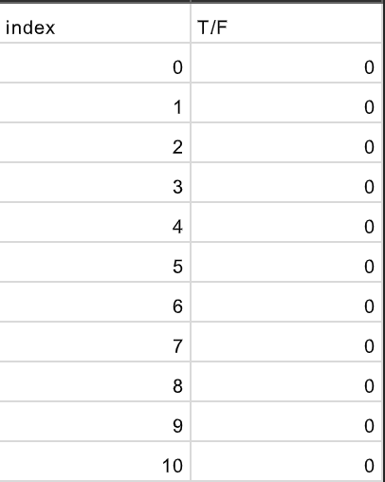
Kaggle submission(40%)
Kaggle link:
https://www.kaggle.com/t/36fbc49fc9d644f0ae9cfc76dae3331b
Display name:<student ID>
- Submission format:
A 1263 X 2 .csv file containing :
- 1 row of column name and 1262 rows of result.
- The column name must be “index” and “T/F”
- Each row contains an index(from 0 to 1261) and a prediction(0 or 1)
There are two baseline (simple and strong)，
I will provide hints about simple baseline on 10/25 14:00.
Get bonus if you achieve the simple baseline before that time.

Slide 6
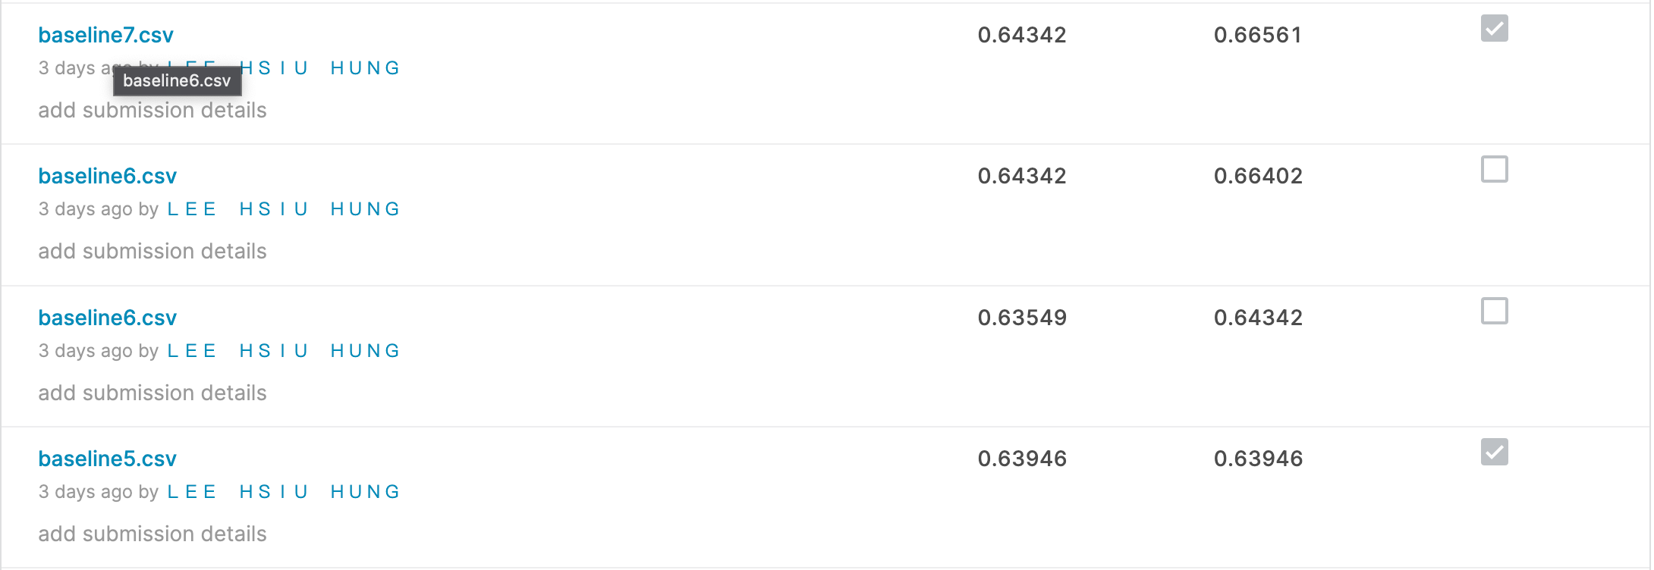
Kaggle submission(40%)
- You may submit up to 5 results each day.
- Up to 2 submissions will be considered for the private leaderboard
Remember to select 2 results
for your final score before
the competition ends!

Slide 7
Report Submission(60%)
Please submit a report containing 3 questions:
1. Describing your methods in detail.(50%)
2. Is there any difference between your expectations and the results? Why?(20%)
3. What difficulties did you encounter in this assignment?
How did you solve it?(30%)

Slide 8
Requirements
- Python only
- No plagiarism !
- At the top of your Source code:
#Author: Hsiu-Hung Lee
#Student ID: 1234567
#HW ID: HW1

Slide 9
E3 Submission
- Deadline:
- Submit Zip to E3 before 11/3 11:59PM
- No Late Submission!
- Format:
- Source code : Hw1_<student ID>.py
- Report file : Hw1_<student ID>.pdf
- Zip file : Hw1_<Student ID>.zip
If you have any question, ask all the TAs by Email.

Slide 10
Grading policy
Kaggle(40%):
- Basic score (according to the public leaderboard):
under simple baseline: 40
over simple baseline: 60 *1.2 If you achieve before TAs provide hints(10/25 14:00)
over strong baseline: 80
Ex:
。If you achieve simple baseline after 10/25 but you don’t achieve strong baseline in the end, your basic score will be 60.
。If you achieve simple baseline before 10/25 but you don’t achieve strong baseline in the end, your basic score will be 72.
。If you achieve simple baseline before 10/25 and you achieve strong baseline in the end, your basic score will be 80.
- Ranking score (according to the private leaderboard) :
score= 20-(20/N)*(ranking-1), N=number of people
Source code and Report(60%):
- the more detail you make, the higher score you get

Slide 11
Timeline
TAs provide hints
Deadline
Hw1 release
10/25
14:00
11/3
23:59
10/13
Simple baseline score: 60*1.2=72
Strong baseline score: 80
Simple baseline score: 60
Strong baseline score: 80

